Slide 1


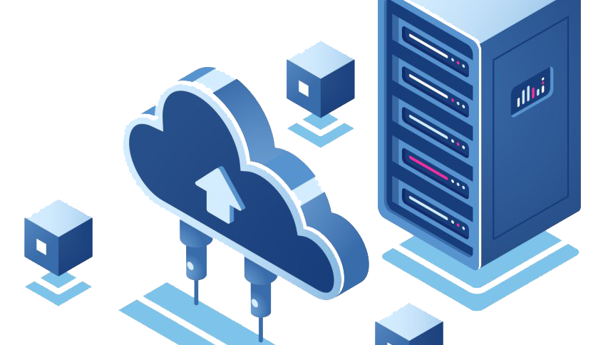
Data Centered Architecture
Abdullah (02-131222-099)

Slide 2


What is Data Centered Architecture?
Data-centered architecture is a software architecture style that focuses on data and how it is accessed and manipulated by different components. The main purpose of this style is to achieve integrity and consistency of data. It focuses on storing, managing, and processing data efficiently to support various applications and business operations.

Slide 3
How does Data Centered Architecture work?
Data-centered architecture consists of a central data store or repository and a collection of data accessors or agents that operate on the data store. The data store is the only means of communication among the data accessors. The architecture consists of three key layers the storage layer, the processing layer, and the presentation layer.
The storage layer is responsible for capturing and persisting data from various sources, such as databases, data lakes, and streaming platforms.
The processing layer performs transformations, aggregations, and analytics on the data, using technologies like distributed computing, big data frameworks, and machine learning.
The presentation layer provides interfaces and tools for users to access and visualize the data, enabling them to derive insights and make informed decisions.

Slide 4

Software Product
Salesforce CRM.
Salesforce CRM is a cloud-based platform that helps businesses manage their customer relationships, sales, marketing, analytics, and more.
It uses a central database to store all the customer data and a set of applications to access and manipulate the data.
It allows users to create custom applications using its platform as a service (PaaS) feature called Force.com.

Slide 5
Thank You

